Slide 1


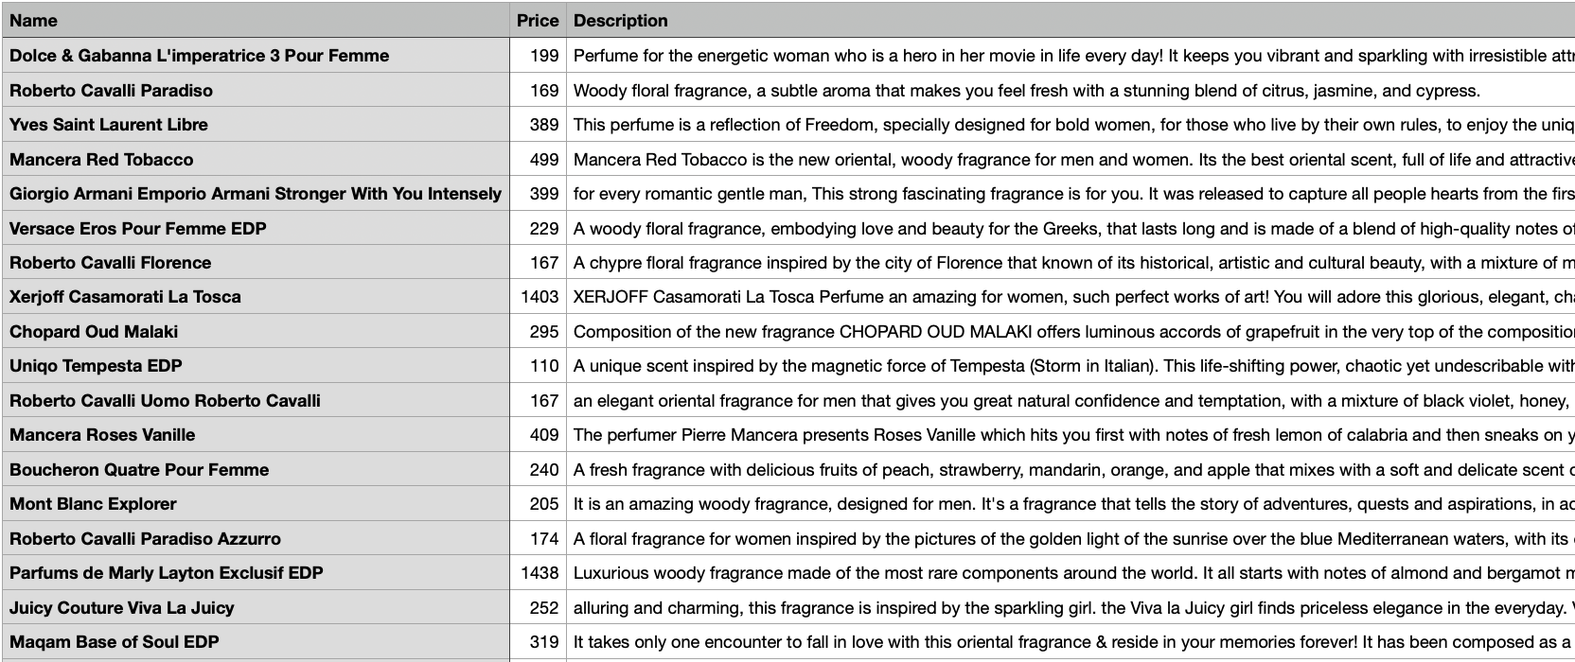
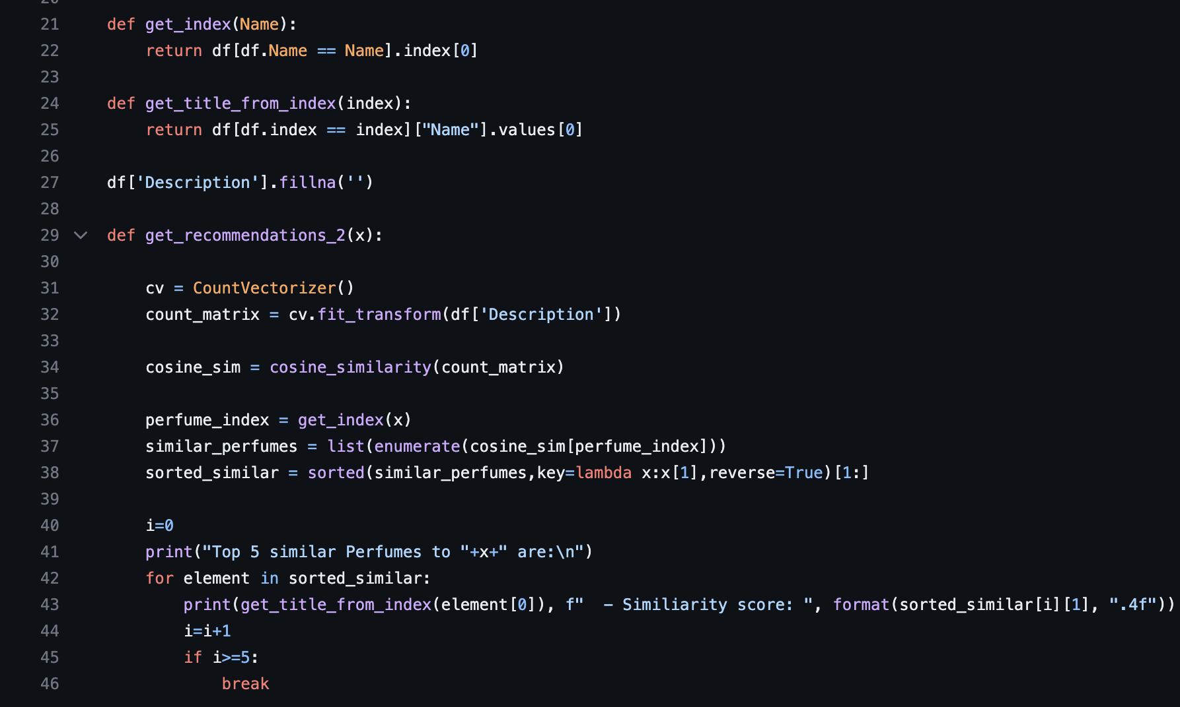
Perfume pocket
Amanda rajda
A software to help find the best suited perfume for you!

